Slide 1


Andreas F.
16.09.2024

Slide 2

Outline
Executive Summary
Introduction
Methodology
Results
Conclusion
Appendix

Slide 3
Executive Summary
Summary of methodologies
Data Collection
Data Wrangling
Exploratory Data Analysis with SQL
Exploratory Data Analysis with Data Visualization
Interactive Visual Analytics with Folium
Interactive Dashboards with Plotly Dash
Summary of all results
Exploratory Data Analysis results
Interactive Analytics in pictures
Predictive Analysis results

Slide 4
Introduction
SpaceX advertises Falcon 9 rocket launches on its website, with a cost of 62 million dollars; other providers cost upward of 165 million dollars each. Much of the savings is because SpaceX can reuse the first stage on their next missions. Therefore if we can determine if the first stage will land, we can determine the cost of a launch. This information can be used for our competitor SpaceY to bid against SpaceX for a rocket launch.
Problems to examine:
Identification of all factors influencing the landing outcome
Finding relationships between all variables and how these affect the outcome
Evaluating best conditions needed to increase the probability of a successful landing

Slide 5

Section 1

Slide 6
Methodology
Executive Summary
Data collection methodology:
SpaceX Rest API
Web Scraping from Wikipedia
Perform data wrangling
Converting categorical data variables for machine learning purposes
Perform exploratory data analysis (EDA) using visualization and SQL
Perform interactive visual analytics using Folium and Plotly Dash
Perform predictive analysis using classification models
Building of Logistic Regression, Support Vector Machine, Decision Tree Classifier and K-Nearest Neighbours models for evaluating the best classifier

Slide 7
Data Collection
Data collection involves gathering and measuring information on specific variables within a predefined system, allowing for the answering of key questions and assessing outcomes. In this case, the dataset was obtained via a combination of REST API and web scraping from Wikipedia.
For the REST API, the process began with a GET request. The response was decoded into JSON format, which was then transformed into a Pandas DataFrame using json_normalize(). After that, the data was cleaned, missing values were identified, and appropriate actions were taken to fill them.
As for web scraping, BeautifulSoup was employed to retrieve launch records formatted as an HTML table. This table was parsed and converted into a Pandas DataFrame for further analysis.

Slide 8
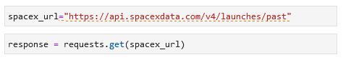
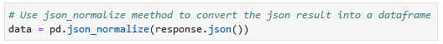
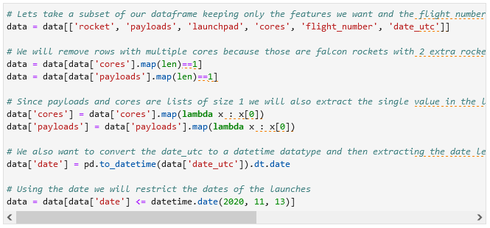
Data Collection – SpaceX API
Getting the request for the rocket launch data using API
Using the json_normalize method to convert the json result to a dataframe
Performing data cleaning and filling the missing value
From: https://github.com/Faqqin/Applied-Data-Science-Capstone-SpaceX/blob/main/Data%20Collection%20API.ipynb

Slide 9
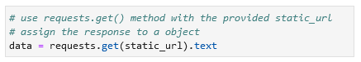
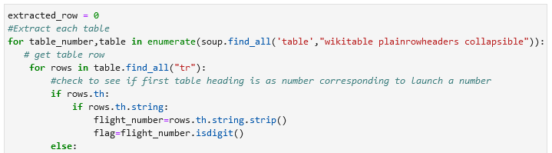
Data Collection - Scraping
Getting the response from HTML
Creating a BeautifulSoup object
Extracting all columns and variable names from the HTML Header
From: https://github.com/Faqqin/Applied-Data-Science-Capstone-SpaceX/blob/main/Data%20Collection%20with%20Webscraping.ipynb

Slide 10
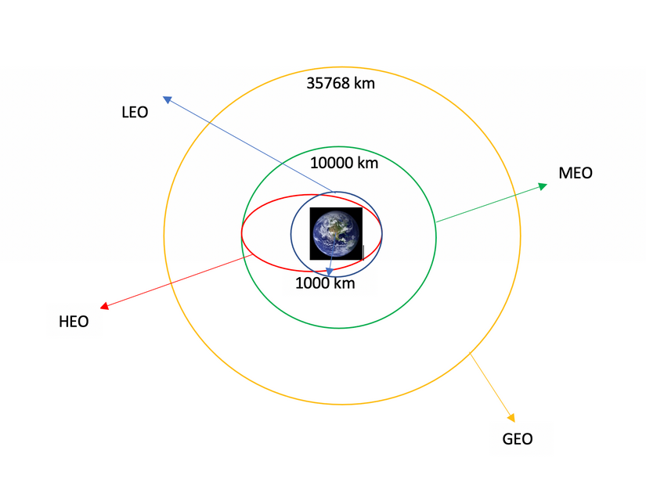
Data Wrangling
Data wrangling refers to the process of transforming and organizing disordered or intricate datasets to make them more accessible for analysis and Exploratory Data Analysis (EDA).
It began by determining the number of launches at each location, followed by calculating the frequency and distribution of mission outcomes for each orbit type.
Afterward, a landing outcome label has been generated based on the outcome column, simplifying future analysis, visualization, and machine learning tasks. Finally, the processed data has been exported as a CSV file.
From: https://github.com/Faqqin/Applied-Data-Science-Capstone-SpaceX/blob/main/Data%20Wrangling.ipynb

Slide 11
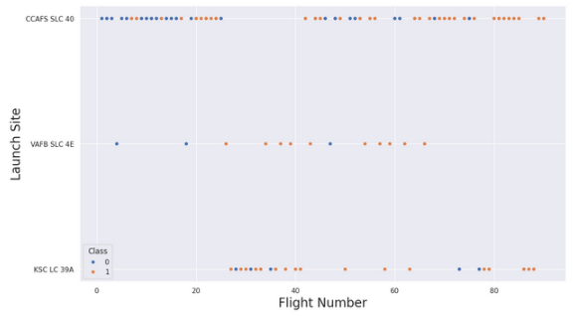
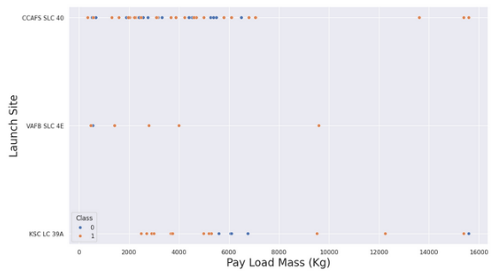
EDA with Data Visualization
At the start scatter graphs were used to find relationships between the following attributes:
Flight number and launch site
Payload mass and launch site
From: https://github.com/Faqqin/Applied-Data-Science-Capstone-SpaceX/blob/main/EDA%20with%20Data%20Visualization.ipynb

Slide 12
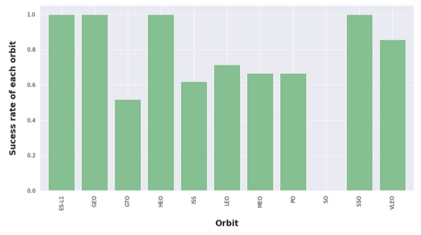
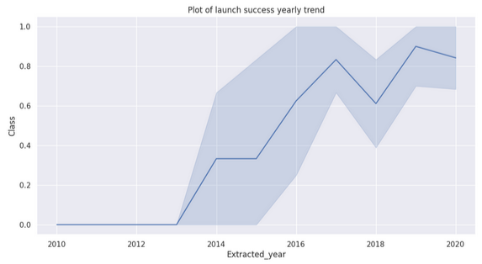
EDA with Data Visualization
Afterwards bar and line charts were used to interpret the relationship between the attributes.
The following bar chart determined which orbits have the highest probability success
The line chart was used to show trends or patterns of attributes over time, in this case the launch success yearly trend
From: https://github.com/Faqqin/Applied-Data-Science-Capstone-SpaceX/blob/main/EDA%20with%20Data%20Visualization.ipynb

Slide 13
EDA with SQL
Using SQL, various queries were executed to gain deeper insights into the dataset, such as:
Retrieving the names of the launch sites.
Fetching 5 records where the launch site names start with 'CCA'.
Calculating the total payload mass carried by boosters launched by NASA (CRS).
Finding the average payload mass for the booster version F9 v1.1.
Identifying the date of the first successful landing outcome on a ground pad.
Listing the boosters that had successful landings on drone ships and carried a payload mass between 4000 and 6000.
Counting the total number of successful and failed mission outcomes.
Listing the booster versions that transported the maximum payload mass.
Retrieving failed landing outcomes on drone ships, along with booster versions and launch site names, for the year 2015.
Ranking landing outcomes or successes between 2010-06-04 and 2017-03-20 in descending order.
From: https://github.com/Faqqin/Applied-Data-Science-Capstone-SpaceX/blob/main/EDA%20with%20SQL.ipynb

Slide 14
Build an Interactive Map with Folium
To create an interactive map for visualizing the launch data, the latitude and longitude coordinates for each launch site have been obtained and a circle marker has been placed at each location, labeled with the launch site name.
Next, the launch_outcomes dataframe (failure, success) has been categorized into classes 0 and 1, using red and green markers, respectively, within a MarkerCluster() on the map.
Then the Haversine formula has been applied to calculate the distances between launch sites and various landmarks to address questions such as:
How close are the launch sites to railways, highways, and coastlines?
How close are the launch sites to nearby cities?
From: https://github.com/Faqqin/Applied-Data-Science-Capstone-SpaceX/blob/main/Interactive%20Visual%20Analytics%20with%20Folium.ipynb

Slide 15
Build a Dashboard with Plotly Dash
An interactive dashboard has been build with Plotly Dash
For showing the total launches by certain sites plotted pie chars were used
To see the relationship between Outcome and Payload mass (kg) for the different booster version, plotted scatter graphs were included
From: https://github.com/Faqqin/Applied-Data-Science-Capstone-SpaceX/blob/main/spacex_dash_app.py

Slide 16
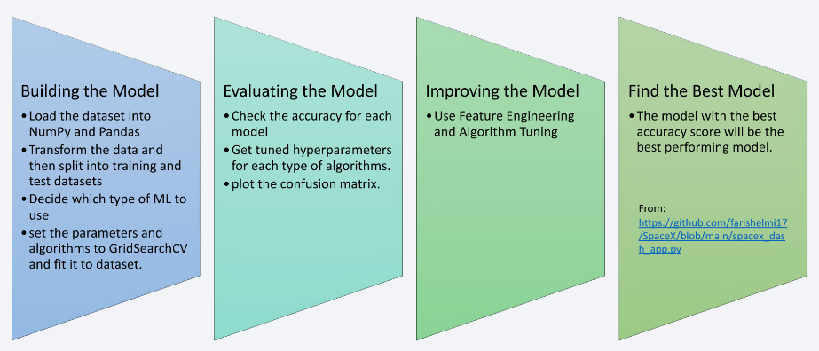
Predictive Analysis (Classification)
From: https://github.com/Faqqin/Applied-Data-Science-Capstone-SpaceX/blob/main/Predictive%20Analysis%20Machine%20Learning.ipynb

Slide 17
Results
Exploratory data analysis results
Interactive analytics demo in screenshots
Predictive analysis results

Slide 18

Section 2

Slide 19

Flight Number vs. Launch Site
The scatter plot shows that the larger the amount of flights at a launch site the greater is the success rate at that launch site

Slide 20

Payload vs. Launch Site
This plot shows that if the pay load mass is higher as around 7.000kg the success rate the success rate gets very high, while at a lower rate it is more unstable.

Slide 21
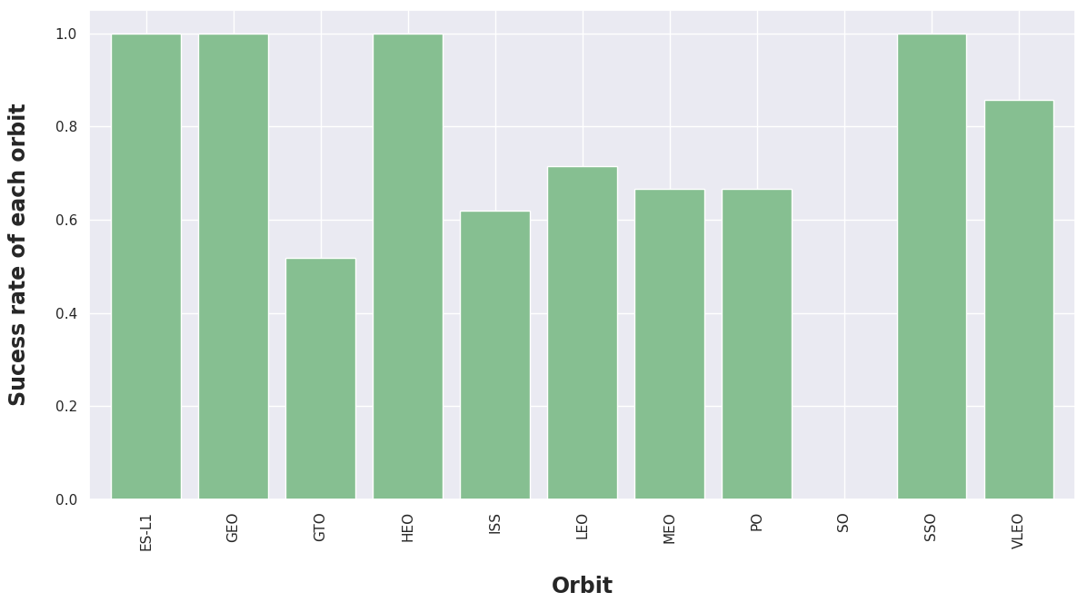
Success Rate vs. Orbit Type
This bar chart describes the success rate of each orbit. While ES-L1, GEO, HEO and SSO have a success rate of 100%, SO, for example, has a success rate of 0%.
Obviously this also heavily depends on the amount of datasets included in the analysis to find more patterns or trends.

Slide 22
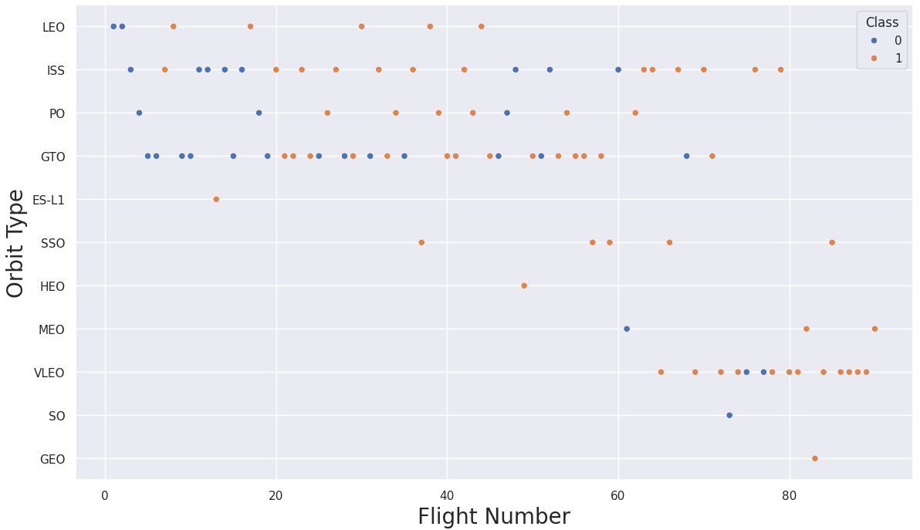
Flight Number vs. Orbit Type
While the GTO orbit shows no relations between the flight number and the flight numbers of the orbit, this plot generally shows a higher success rate when the numbers of flights increases.

Slide 23
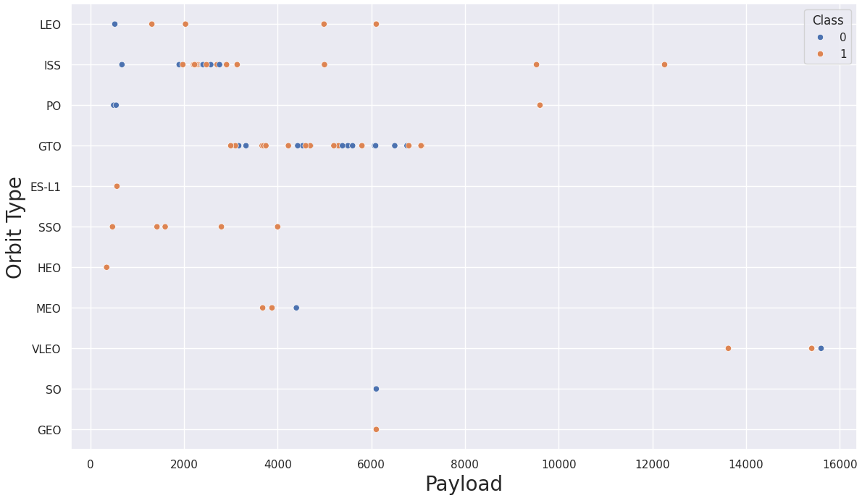
Payload vs. Orbit Type
In this plot we can see that heavier payload has a positive impact on the LEO, ISS and PO orbits. While there again seems to be no relation for the GTO orbit between these attributes, the rest the orbits need more data to get any conclusion.

Slide 24
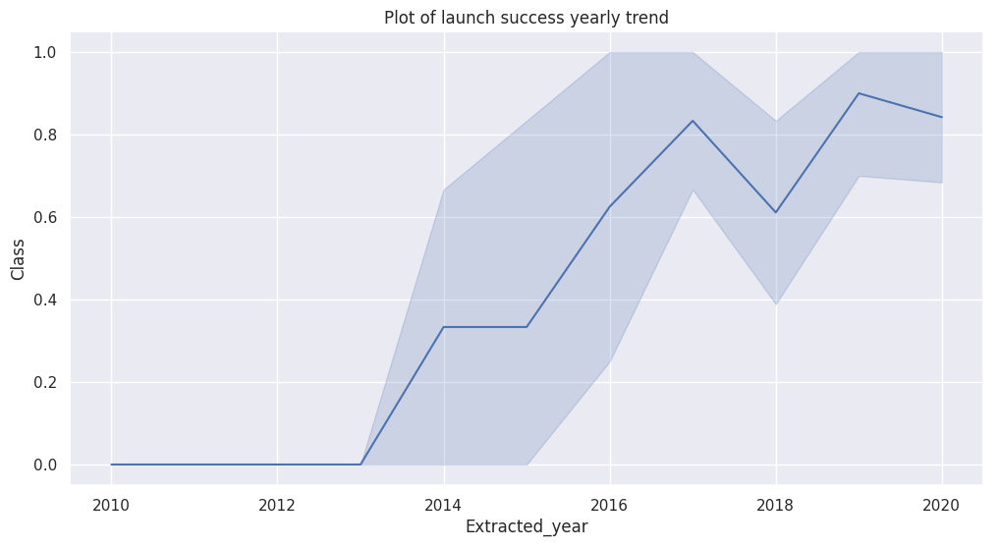
Launch Success Yearly Trend
The success rate in this plot the increasing success rate from year to year since 2010 to 2020.

Slide 25
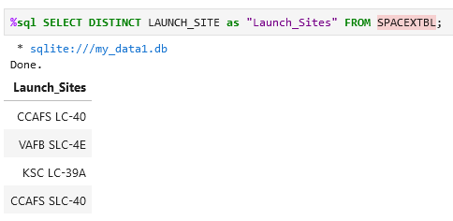
All Launch Site Names
To find the unique launch site names we used the key word DISTINCT:

Slide 26
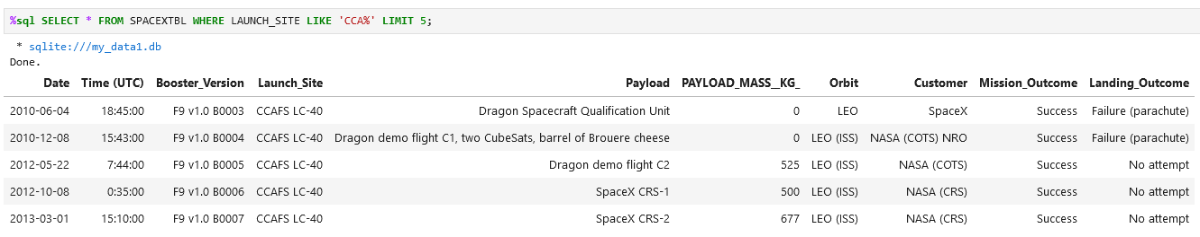
Launch Site Names Begin with 'CCA'
This query shows 5 records where the launch sites starts with CCA using ‘%’ as wildcard character:

Slide 27
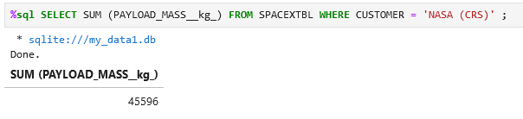
Total Payload Mass
We choose ‘NASA (CRS)’ as customer and sum the payload_mass_kg to get 45.596kg:

Slide 28
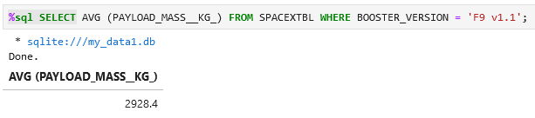
Average Payload Mass by F9 v1.1
In this example the function AVERAGE (AVG) is used. This one returns the average value of the payload mass by F9 v1.1.

Slide 29
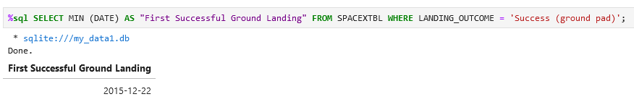
First Successful Ground Landing Date
The first successful ground landing date was on the 22. December in 2015. To get this return we used MIN-Function and filtered the specific landing outcome.

Slide 30
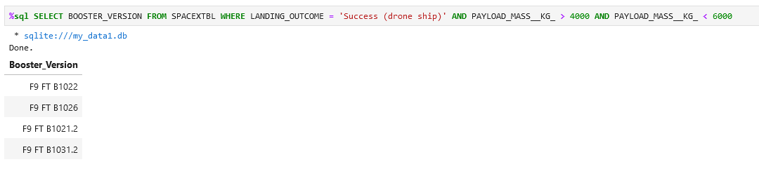
Successful Drone Ship Landing with Payload between 4000 and 6000
The following list shows every successful drone ship landing while having a payload between 4000 and 6000.

Slide 31
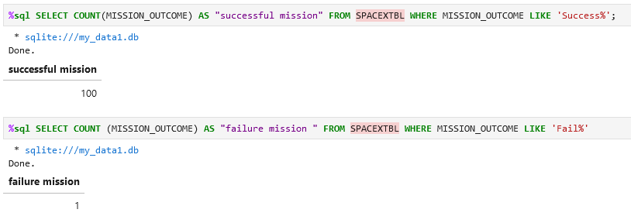
Total Number of Successful and Failure Mission Outcomes
In total we have 100 successful missions and 1 failure mission as outcomes.

Slide 32
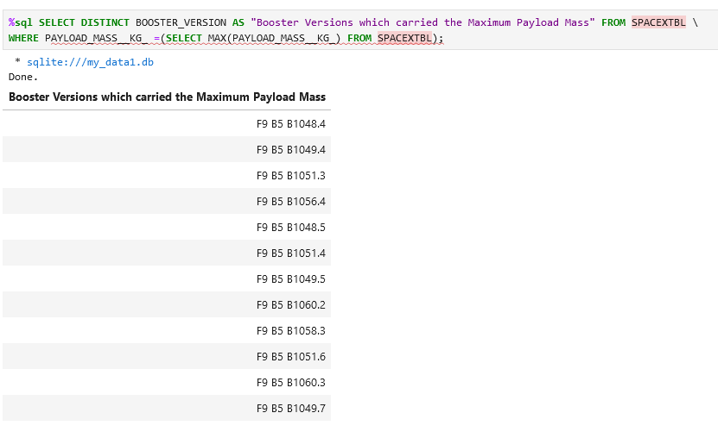
Boosters Carried Maximum Payload
The query on the right returned every unique booster version which carried the maximum payload mass.

Slide 33
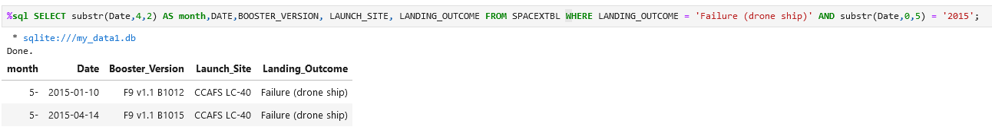
2015 Launch Records
With the function substr we got the month and also the year for the filtering. By also filtering after LANDING_OUTCOME we got two results for failed launch records in 2015.

Slide 34
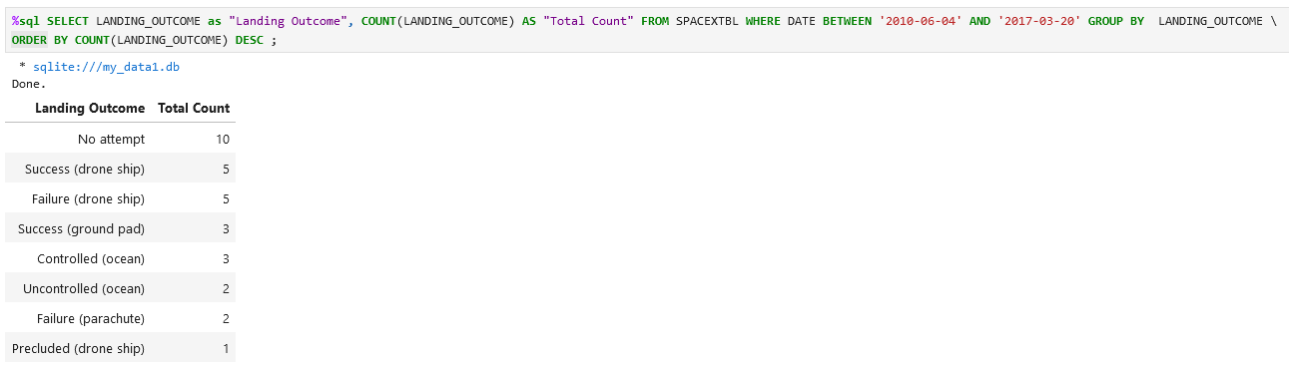
Rank Landing Outcomes Between 2010-06-04 and 2017-03-20
Between 04.06.2020 and 20.03.2017 we had 10 counts of zero landing outcomes, while we had 5 successful and 5 unsuccessful outcomes of drone ship landings.

Slide 35

Section 3

Slide 36
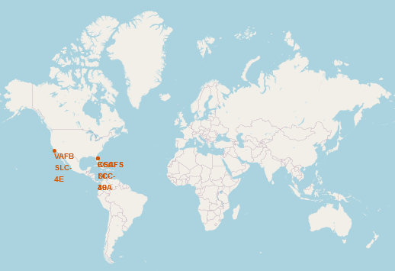
All launch sites markers on a global map
The SpaceX launch sites are in the United States of America, in Florida and California.
Both are located at coasts.

Slide 37
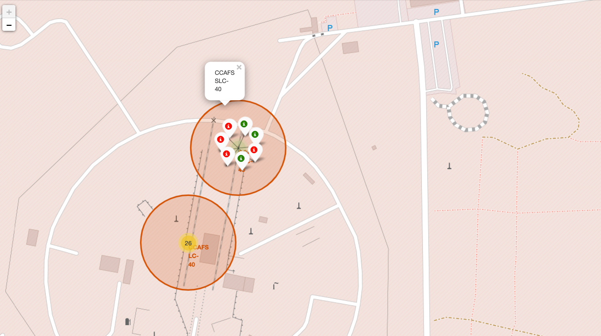
Successors vs failures in color
Green markers show the successful launches, while the red ones show every failure.

Slide 38
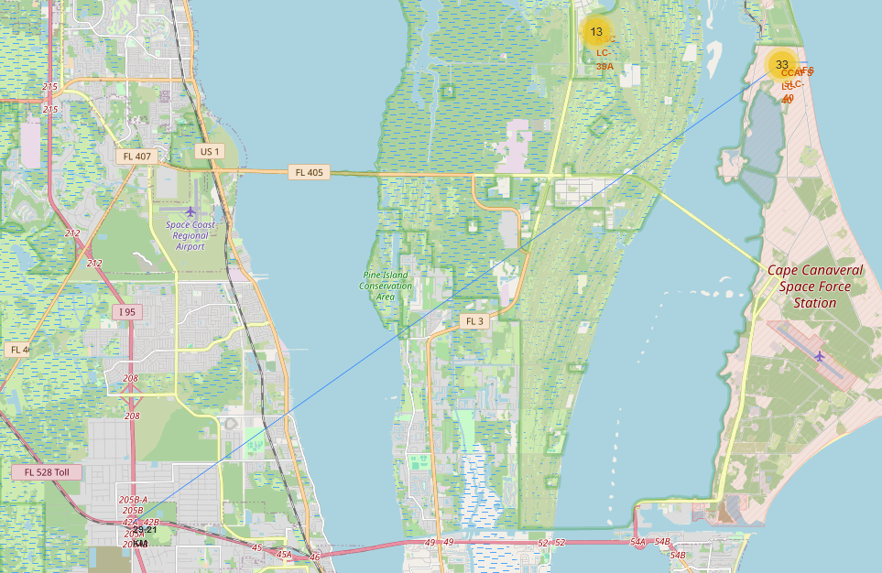
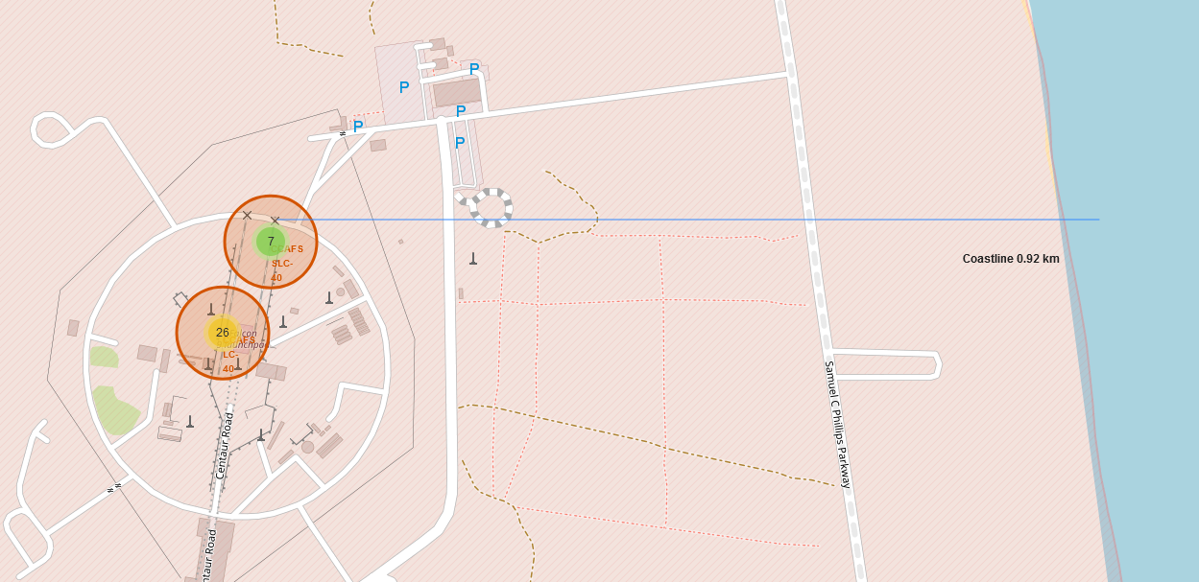
Calculating distances to its proximities
Launch sites, like in the following examples of the CCAFS-SLC-40 shown, are not in proximity of cities but for sure in proximity of coastlines, highways and railways.

Slide 39

Section 4

Slide 40
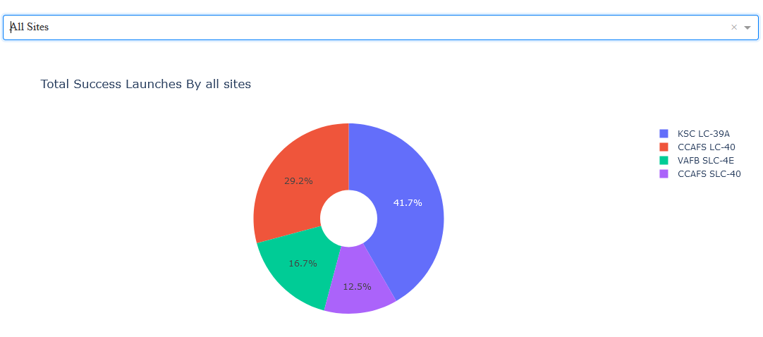
Comparing the total success launches by all sites
The following pie chart shows that the KSC LC-39A launch site had the most successful launches from all the sites.

Slide 41
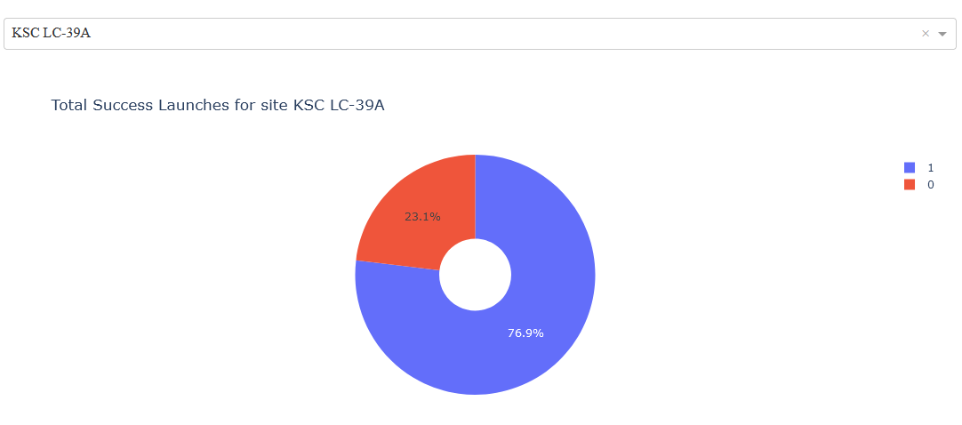
Highest launch success launch site
The KSC LC-39A launch site achieved a success rate of 76.9% while getting a 23.1 failure rate.

Slide 42
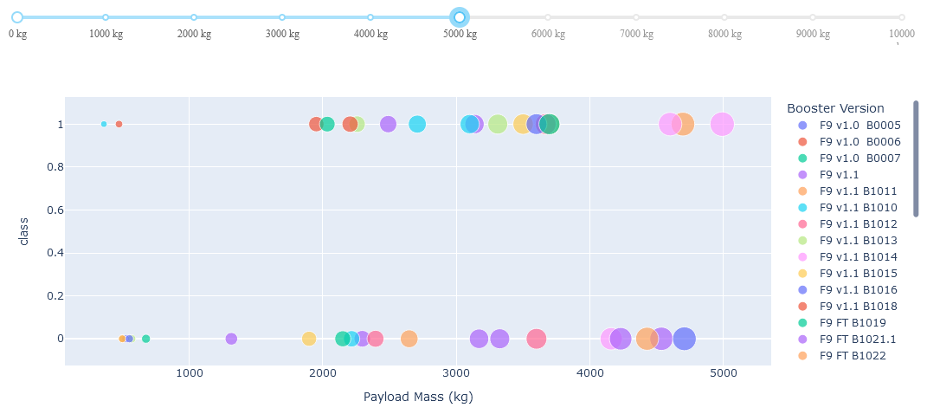
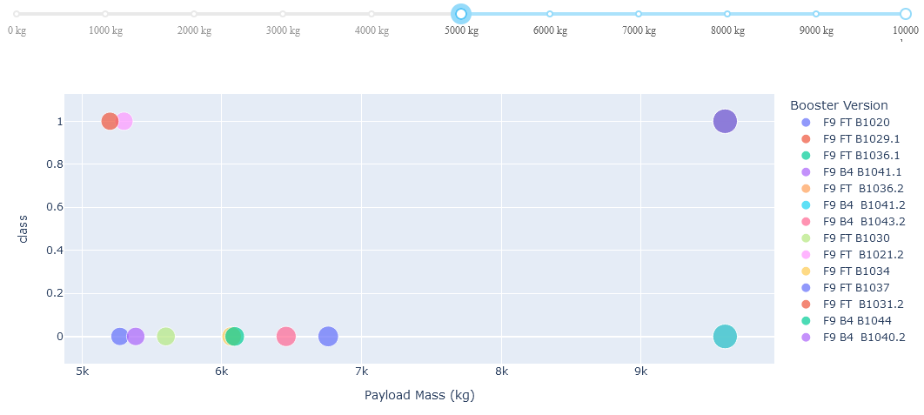
Payload Mass VS Launch Outcome
The two scatter plots show low weighted payload from 0kg to 5.000kg on the left and heavy weighted payload from 5.000kg to 10.000kg on the right. As seen in these plots, the success rates for low weighted payloads is quite higher than the heavy weighted payloads.

Slide 43

Section 5

Slide 44
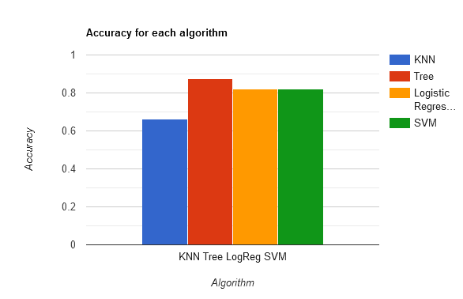
Classification Accuracy
The bar chart on the left shows the accuracies for all four algorithms.
The tree one has the highest classification accuracy with 87,68%.

Slide 45
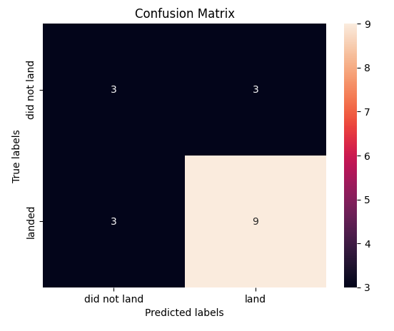
Confusion Matrix
The matrix shows predicted and true labels regarding labels.
The main problem are the false positives, meaning unsuccessful landings predicted as successful landings by the classifier.

Slide 46
Conclusions
In conclusion, we can observe the following:
A higher number of flights at a launch site correlates with a higher success rate.
The launch success rate saw a steady increase from 2013 to 2020.
The orbits ES-L1, GEO, HEO, SSO, and VLEO had the highest success rates.
KSC LC-39A recorded the most successful launches among all sites.
The Decision Tree classifier proved to be the most effective machine learning algorithm for this analysis.

Slide 47


